Slide 1



mock data model, dashboard, reports, by Apurva Dave, 9 Apr 2026
View in Power BI
Last data refresh:
4/9/2026 4:19:25 PM UTC
Downloaded at:
4/9/2026 7:15:31 PM UTC

Slide 2
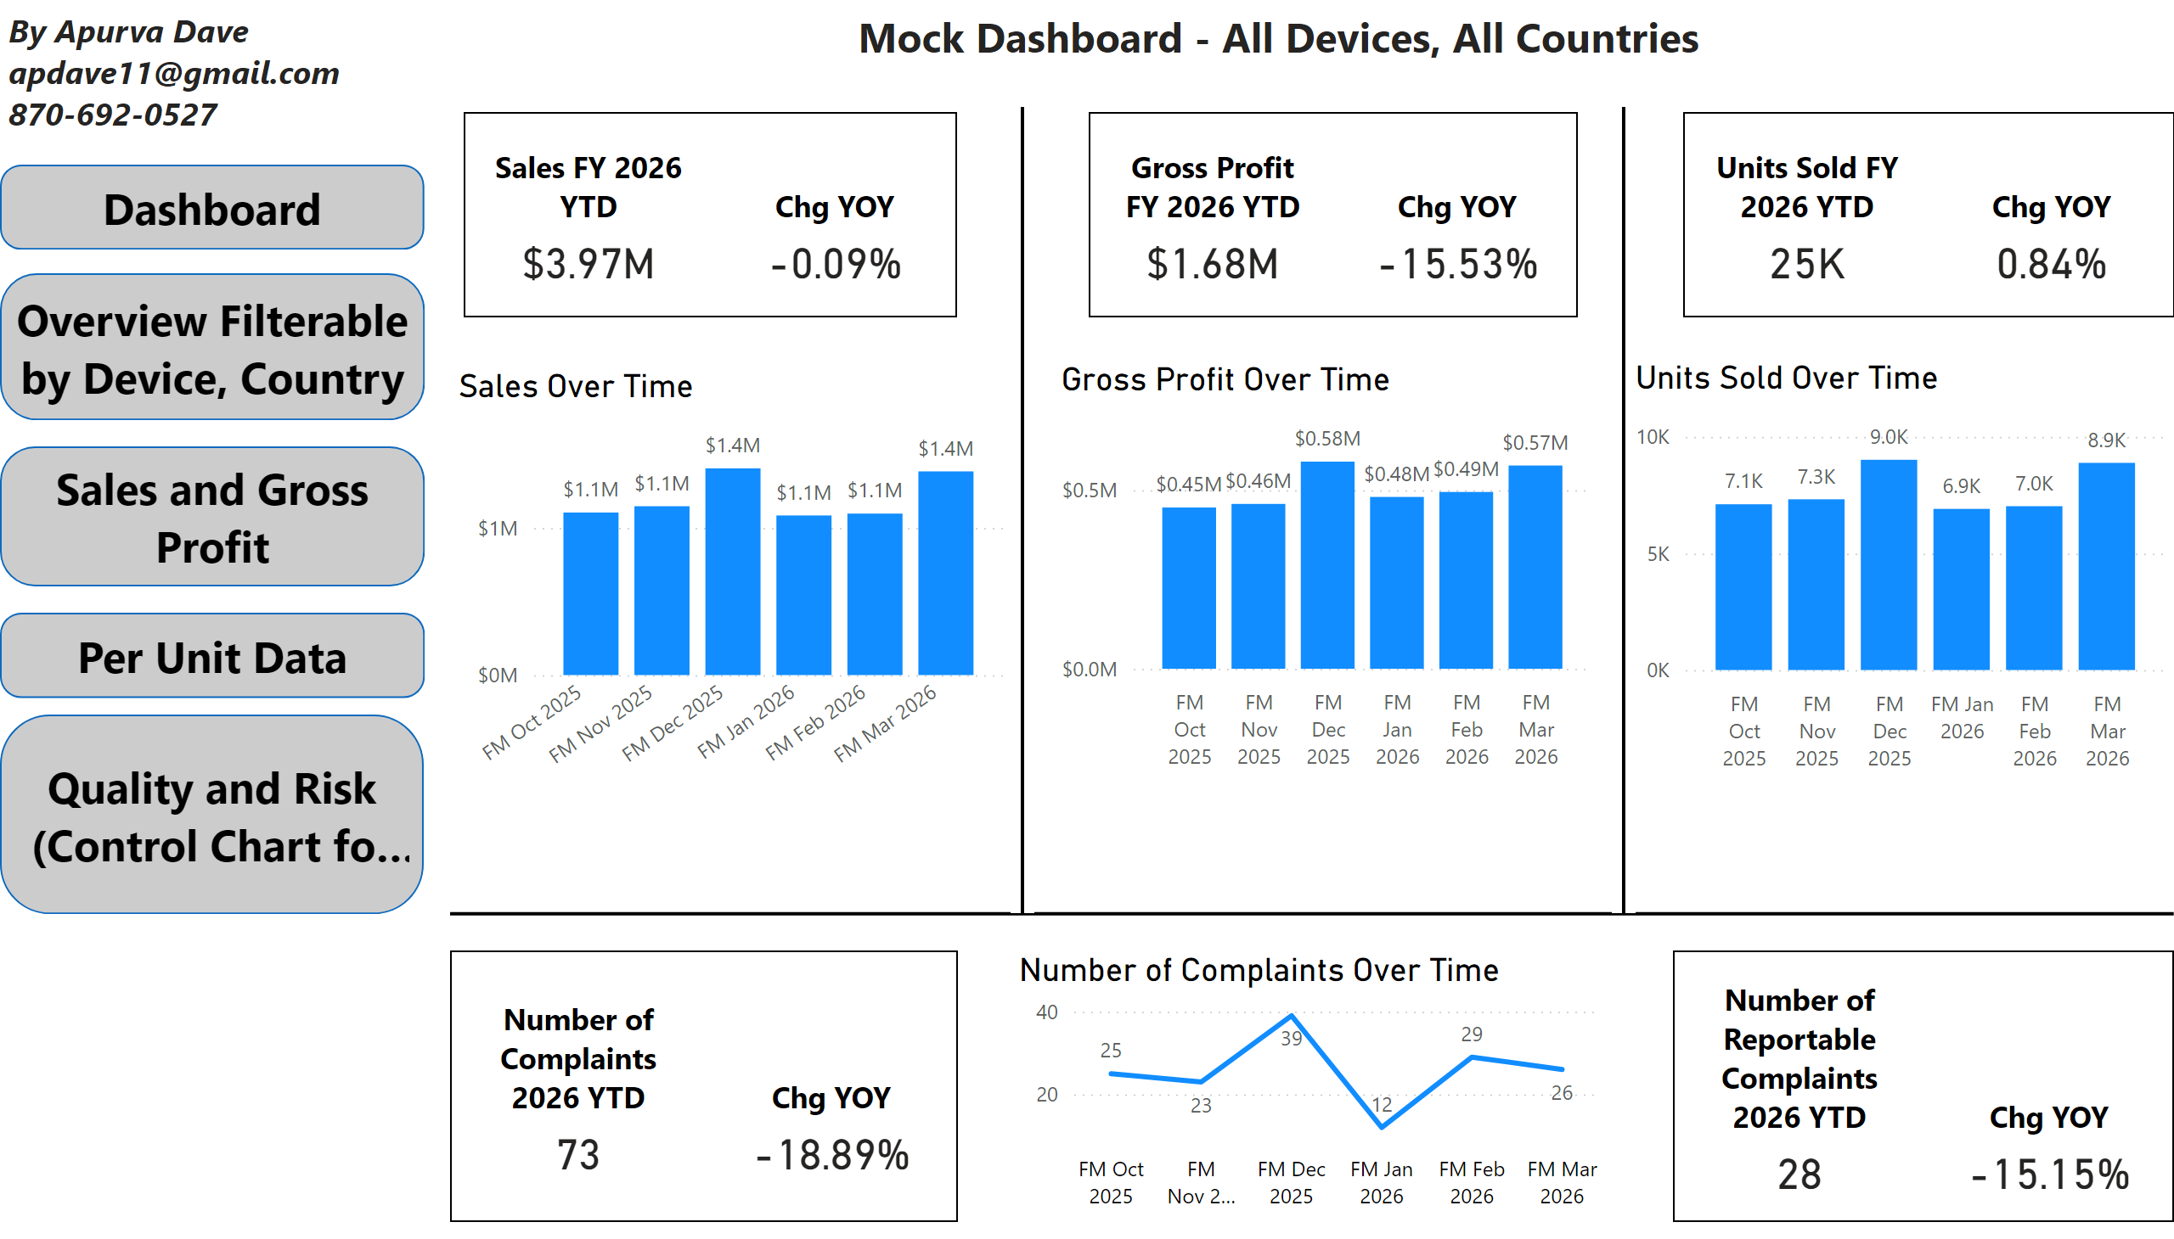
Dashboard
Notes:
shape
No alt text provided
shape
No alt text provided
shape
No alt text provided
cardVisual
No alt text provided
cardVisual
No alt text provided
cardVisual
No alt text provided
Sales Over Time
No alt text provided
Gross Profit Over Time
No alt text provided
cardVisual
No alt text provided
Units Sold Over Time
No alt text provided
cardVisual
No alt text provided
Number of Complaints Over Time
No alt text provided
shape
No alt text provided
textbox
No alt text provided
shape
No alt text provided
shape
No alt text provided
shape
No alt text provided
shape
No alt text provided
textbox
No alt text provided

Slide 3
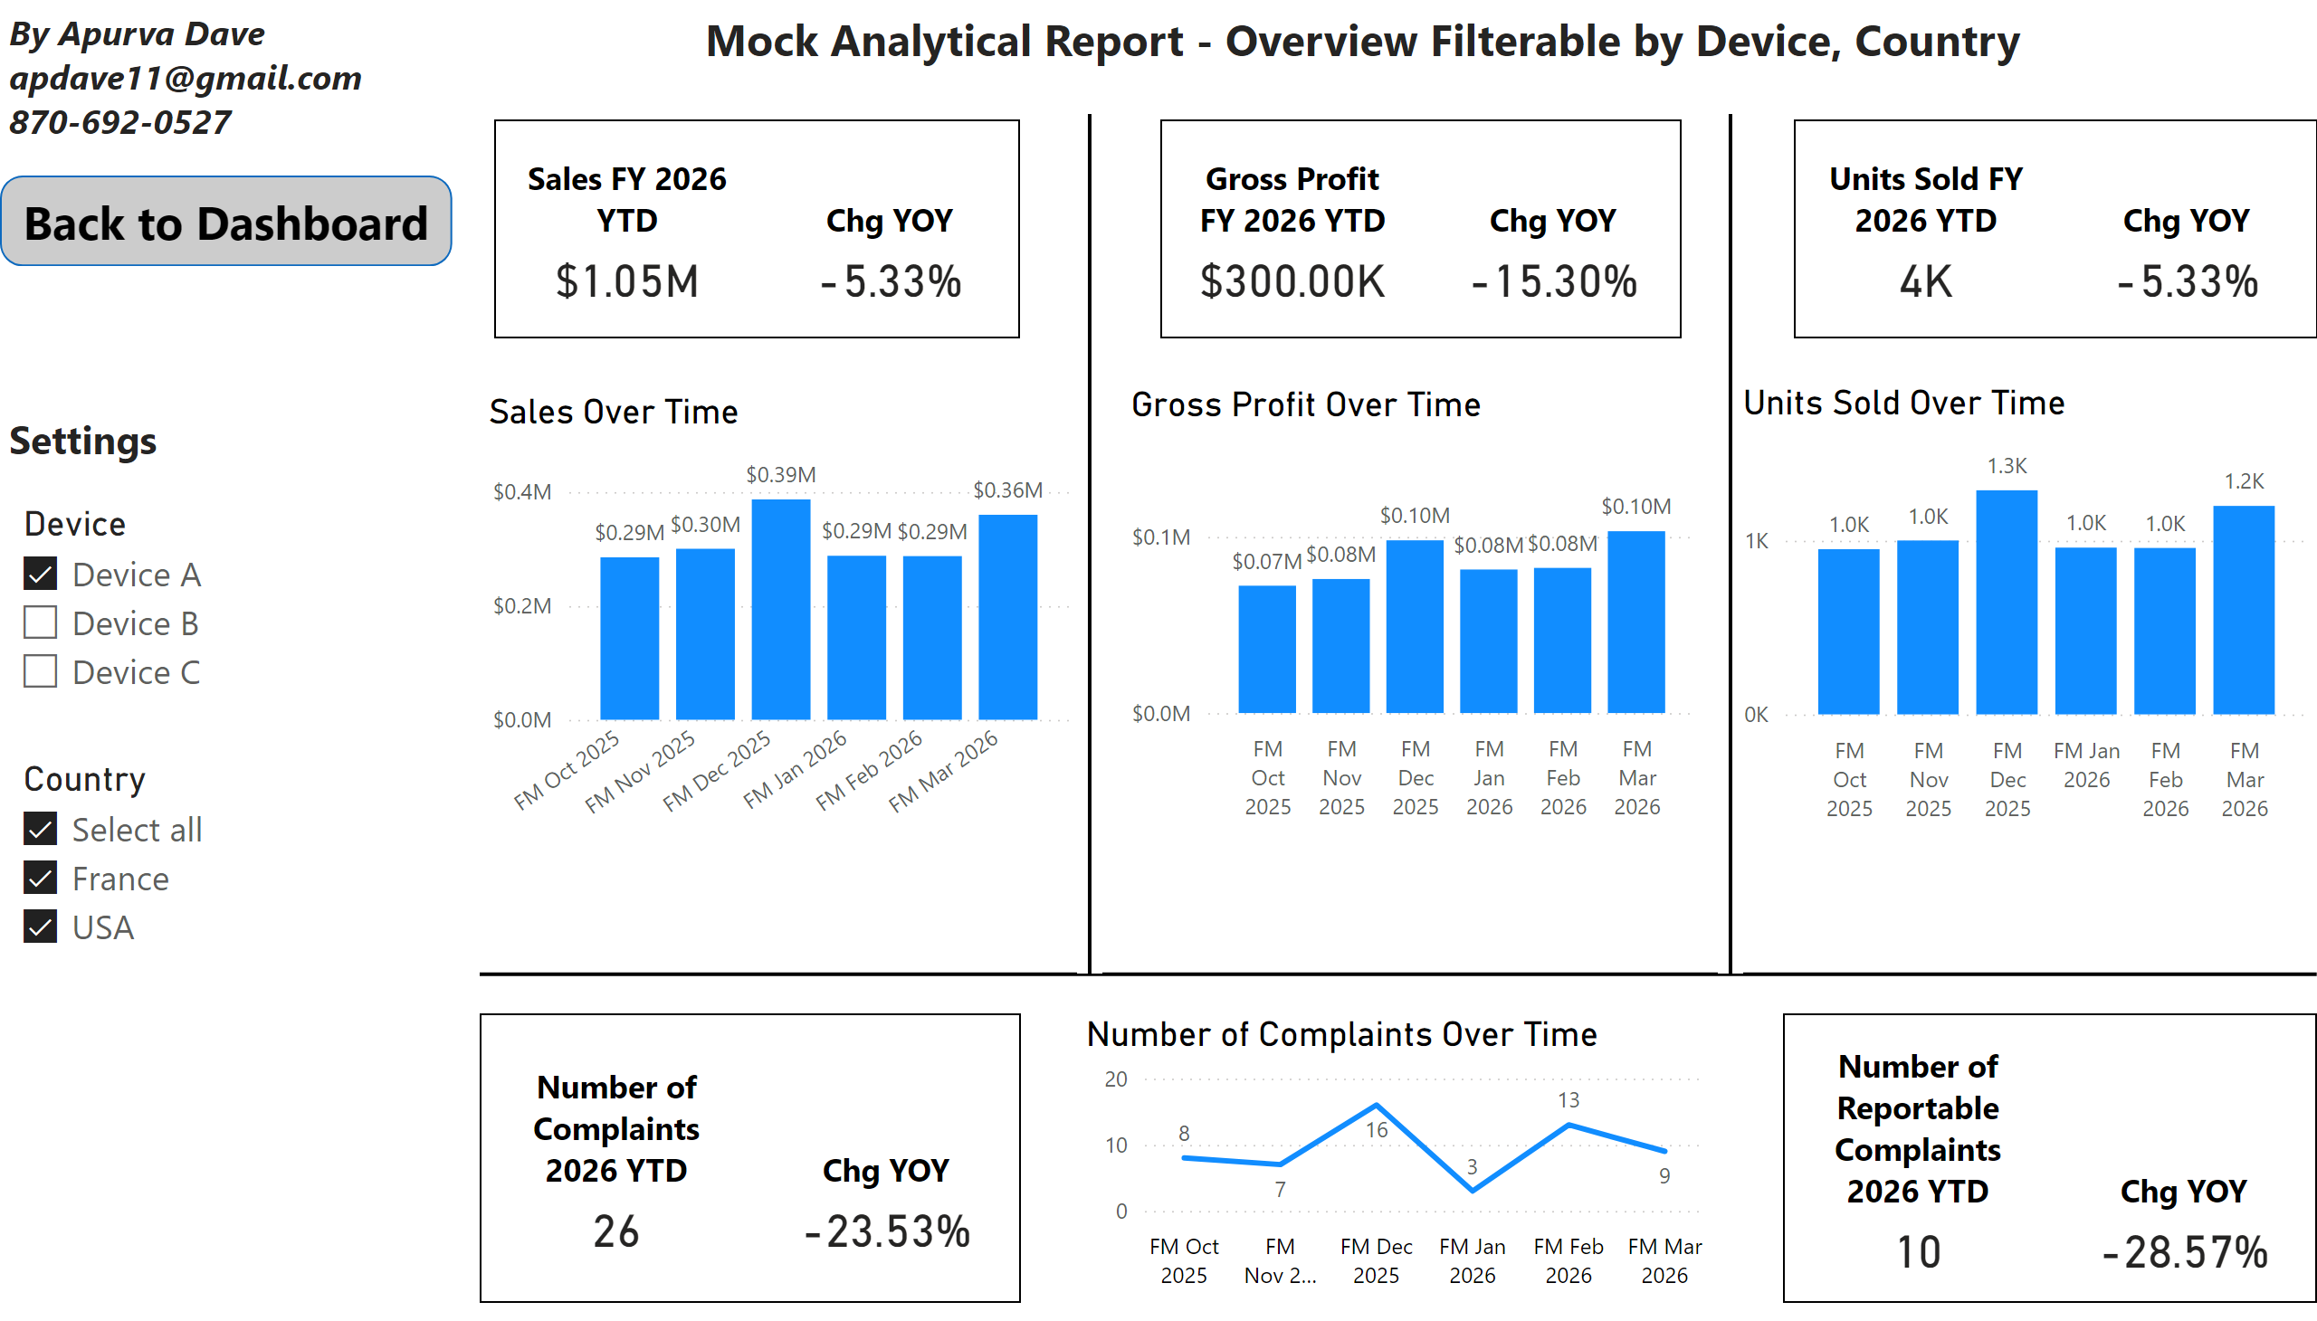
Overview Filterable by Device, Country
Notes:
slicer
No alt text provided
slicer
No alt text provided
shape
No alt text provided
cardVisual
No alt text provided
cardVisual
No alt text provided
cardVisual
No alt text provided
Sales Over Time
No alt text provided
Gross Profit Over Time
No alt text provided
cardVisual
No alt text provided
Units Sold Over Time
No alt text provided
cardVisual
No alt text provided
Number of Complaints Over Time
No alt text provided
shape
No alt text provided
textbox
No alt text provided
shape
No alt text provided
shape
No alt text provided
textbox
No alt text provided
textbox
No alt text provided

Slide 4
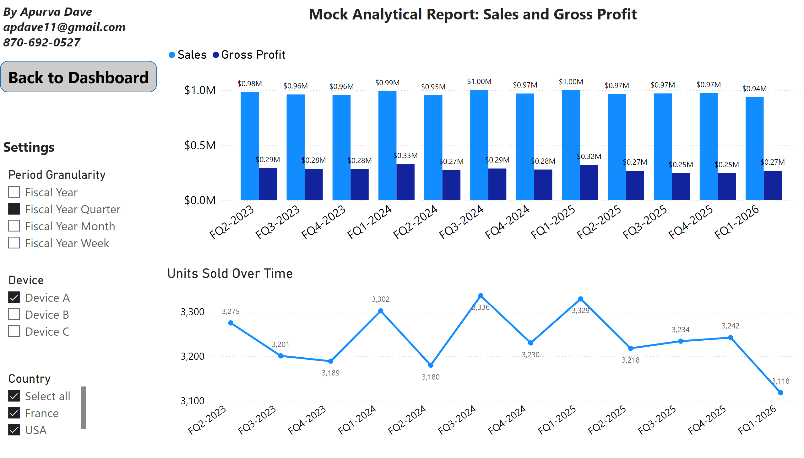
Sales and Gross Profit
Notes:
Sales and Gross Profit
No alt text provided
textbox
No alt text provided
textbox
No alt text provided
slicer
No alt text provided
slicer
No alt text provided
slicer
No alt text provided
Units Sold Over Time
No alt text provided
shape
No alt text provided
textbox
No alt text provided

Slide 5
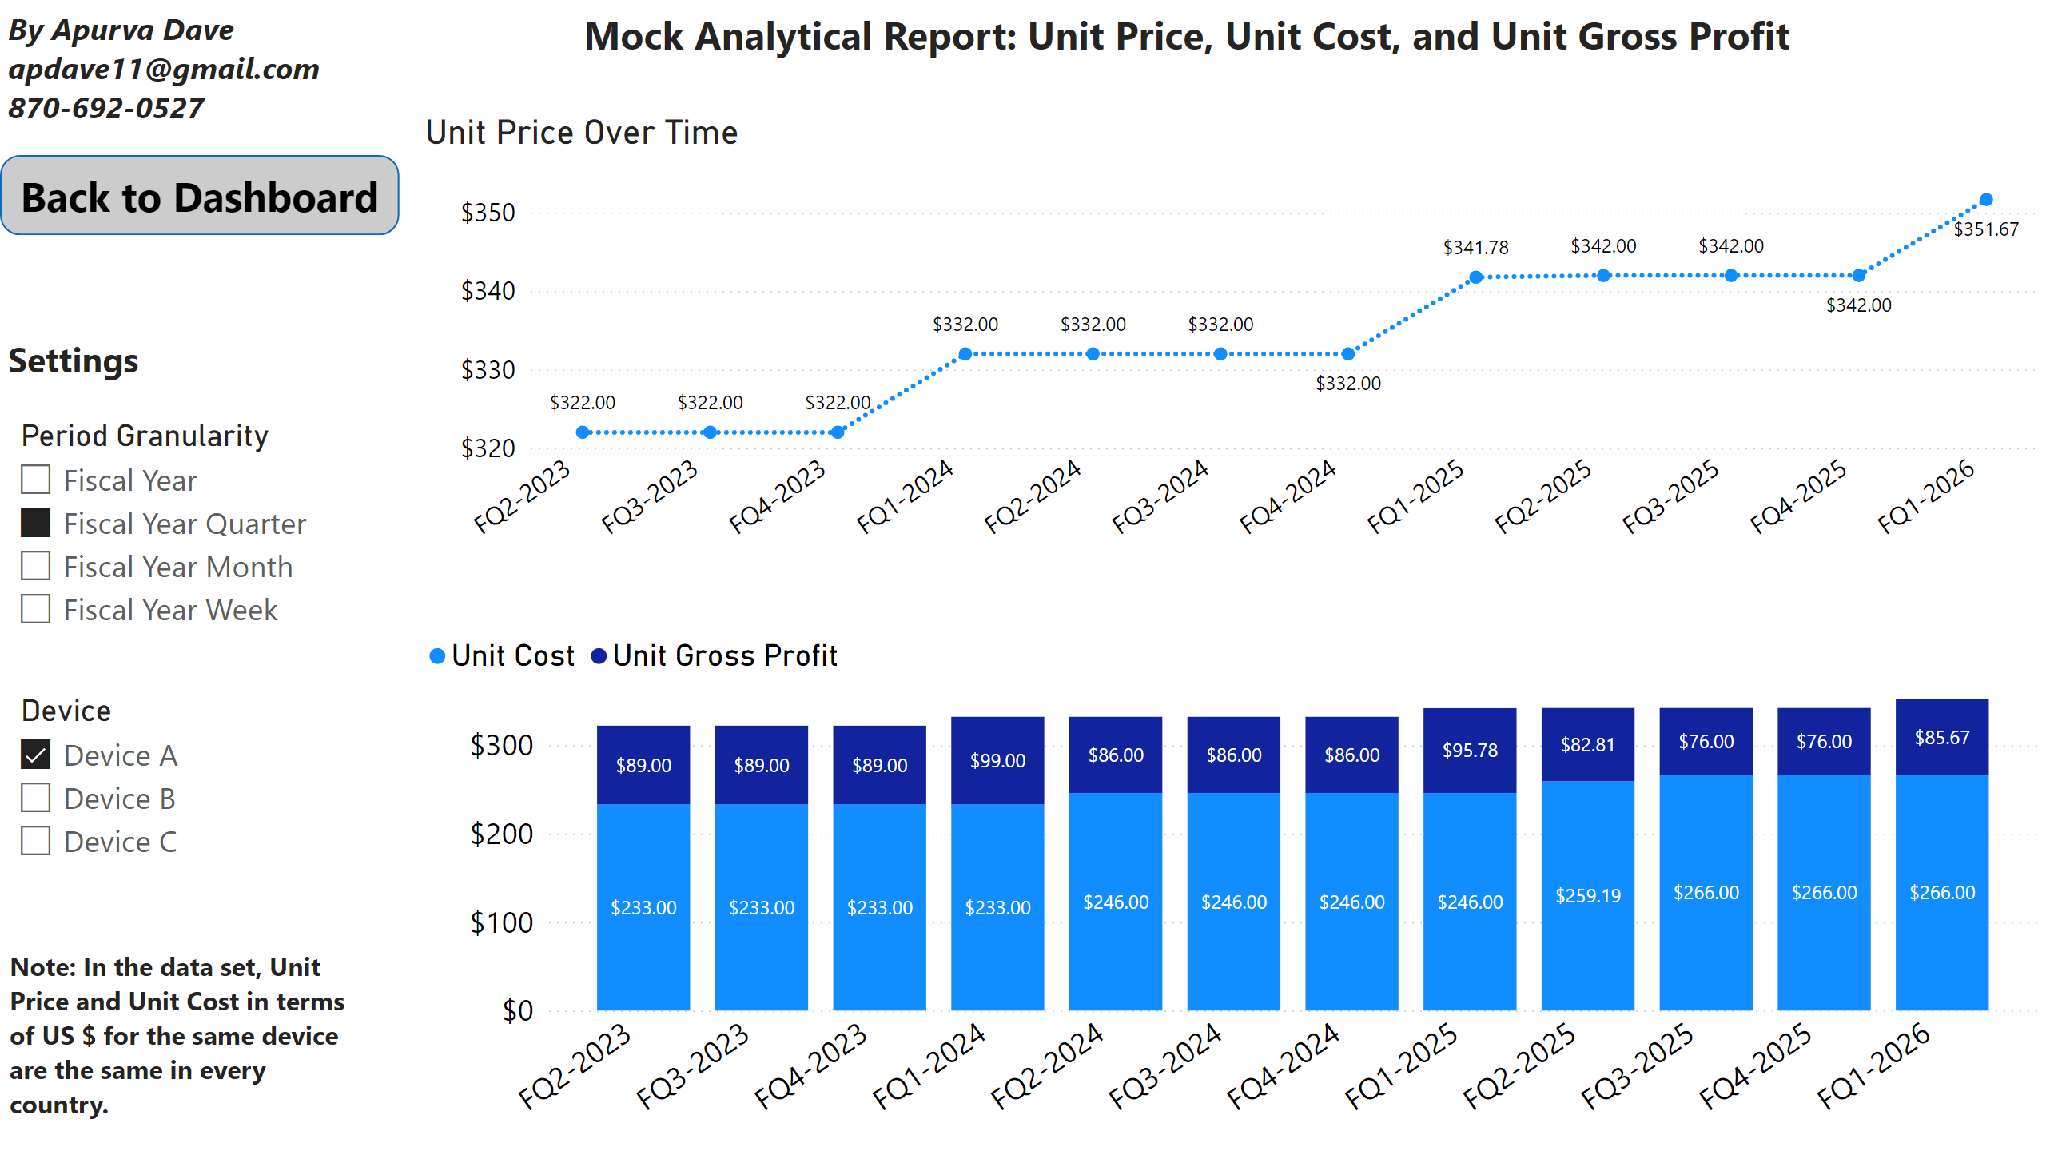
Per Unit Data
Notes:
Sales and Gross Profit
No alt text provided
textbox
No alt text provided
textbox
No alt text provided
slicer
No alt text provided
slicer
No alt text provided
slicer
No alt text provided
Unit Price Over Time
No alt text provided
shape
No alt text provided
textbox
No alt text provided
textbox
No alt text provided

Slide 6
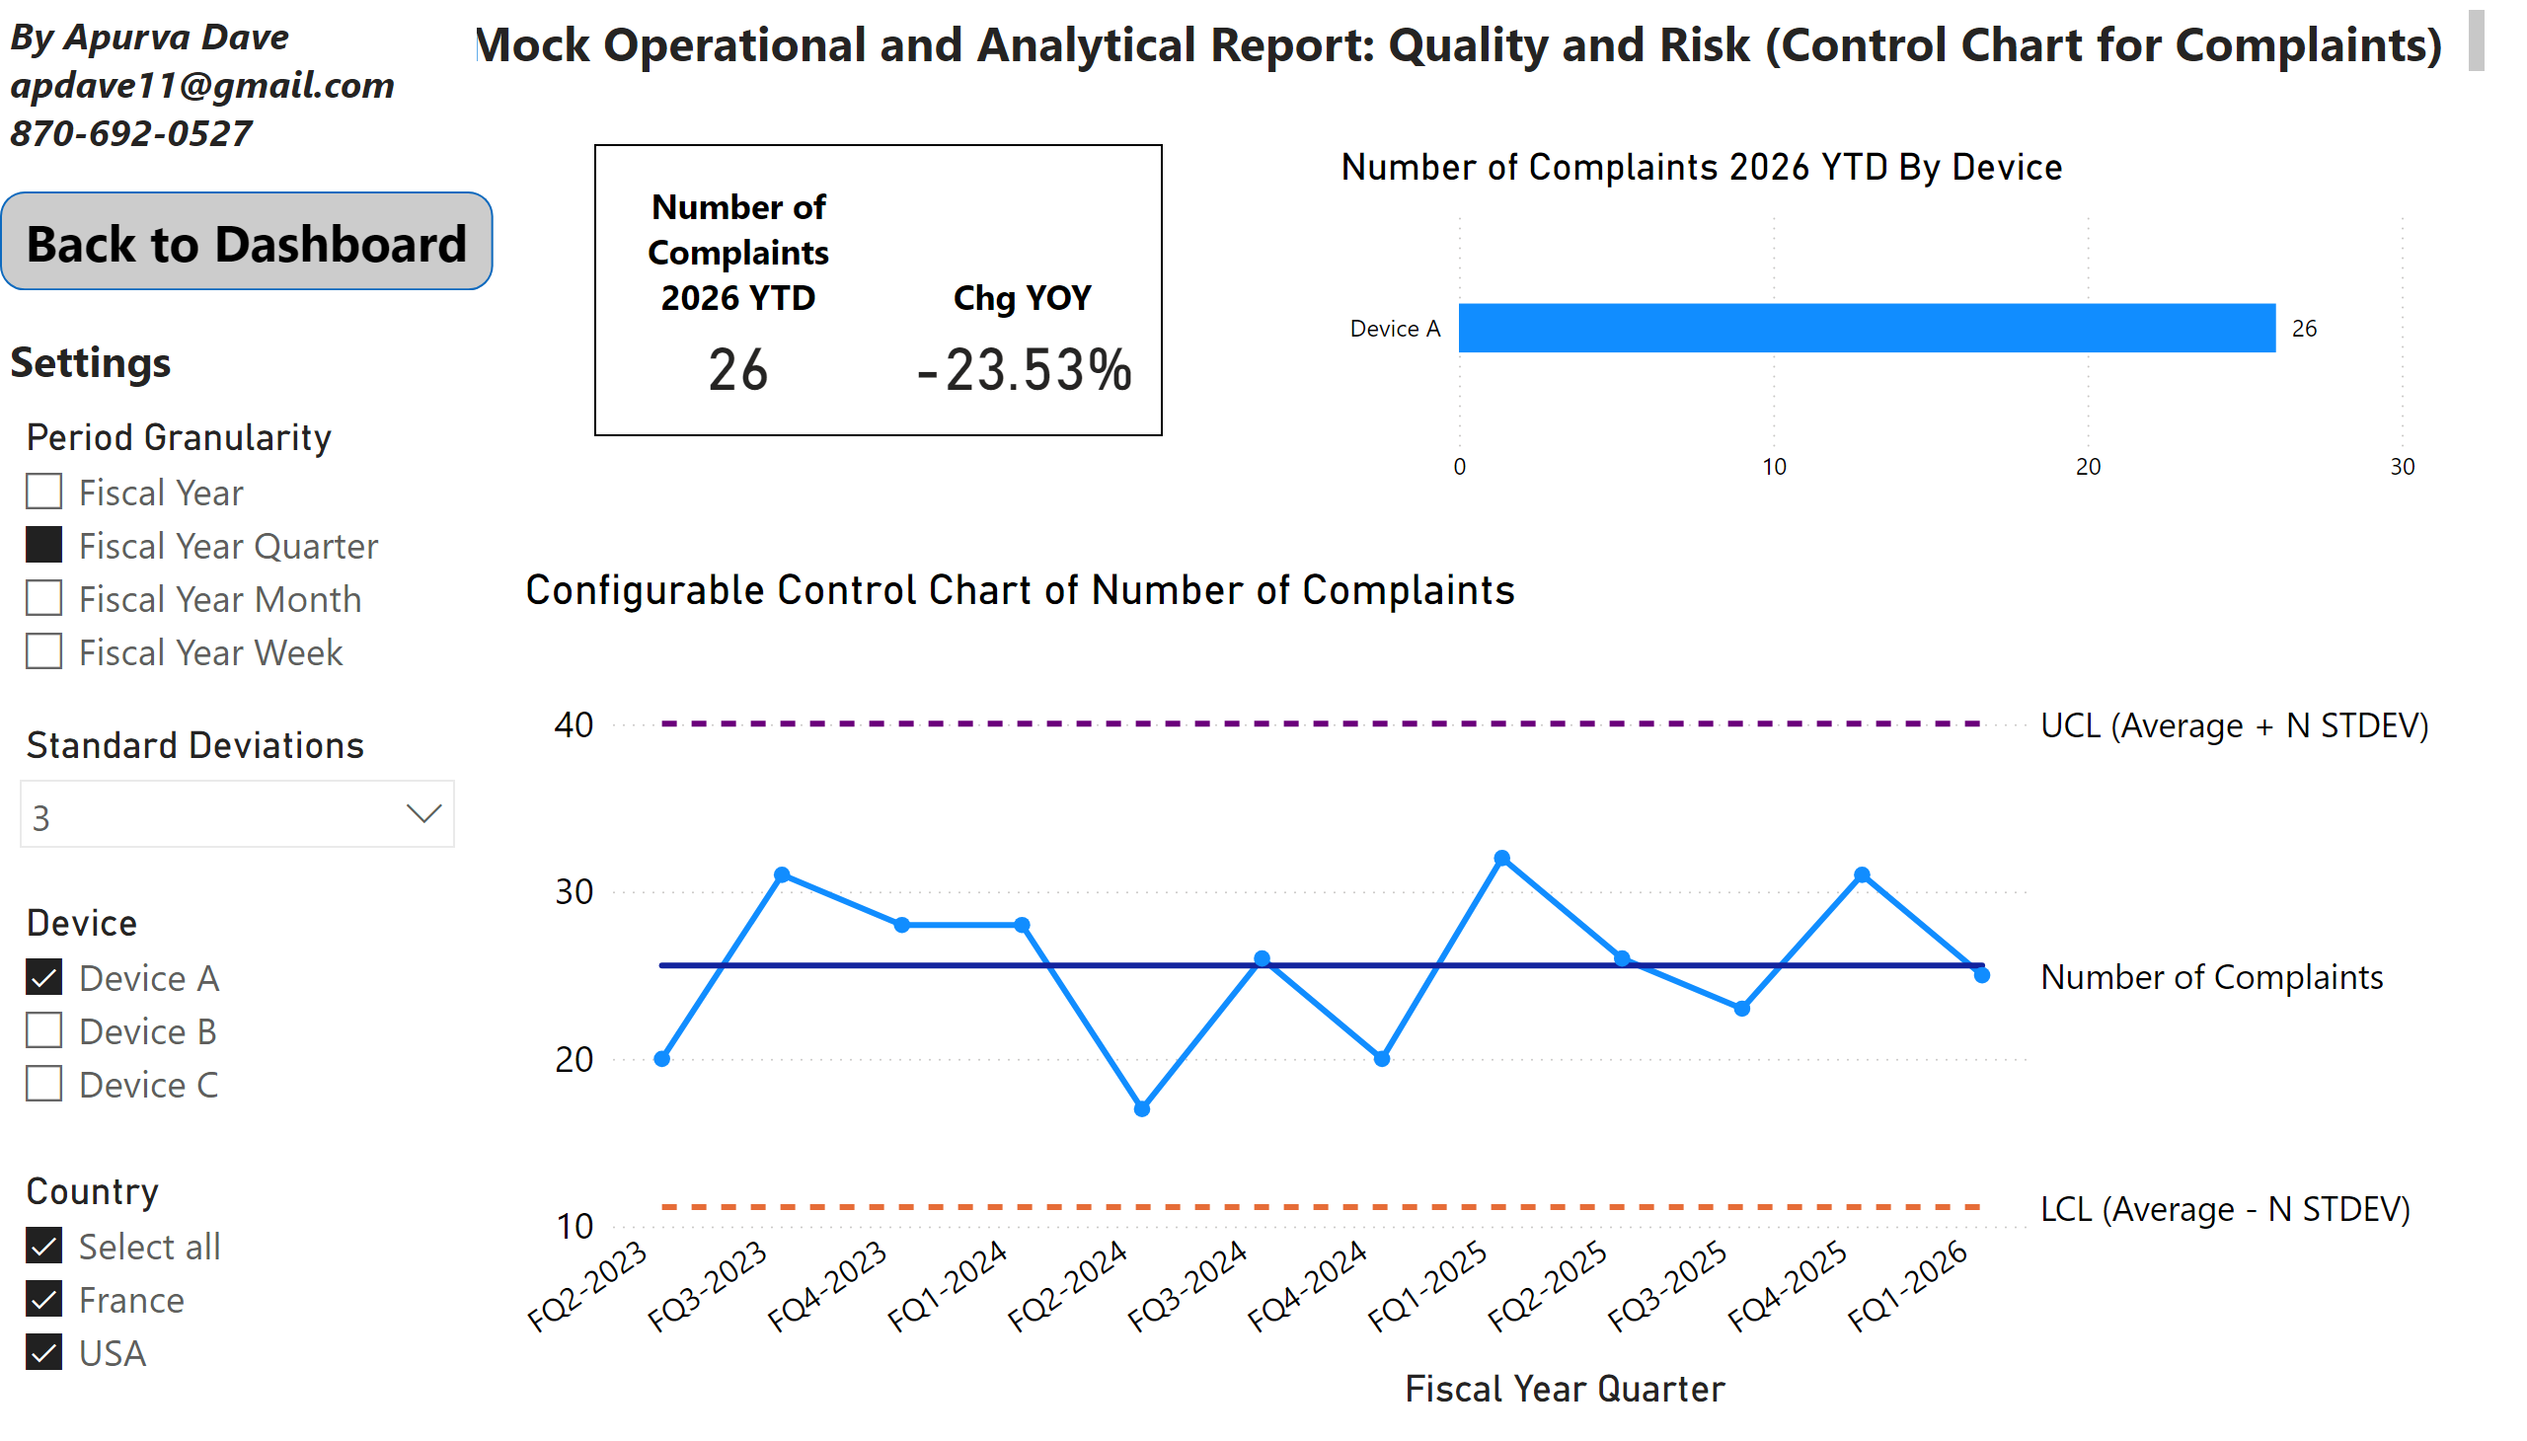
Quality and Risk (Control Chart)
Notes:
Configurable Control Chart of Number of Complaints
No alt text provided
textbox
No alt text provided
textbox
No alt text provided
slicer
No alt text provided
slicer
No alt text provided
slicer
No alt text provided
slicer
No alt text provided
cardVisual
No alt text provided
Number of Complaints 2026 YTD By Device
No alt text provided
shape
No alt text provided
textbox
No alt text provided

